Slide 1
Money On The Table
Fiserv Developer Portal Hackathon
Param
______________________________________

Slide 2

Focuses on Transactional Data on one view talking money that was in hand but has left the table through periodic focus and Addressing
1. Reversal / Refund
2. Disputes on Transactions
Developer Portal can be the key value add to take this visually for
Merchant Business
What is “Money On The Table”?

Slide 3



Merchant Business Problems
Service / Customer Experience
Process / Technology
Lack of trust or assurance due to service personnel / Unpleasant face to face experience at a retail Business
A duplicate transaction in system is that is needs Remediation or Decline on an Authorization tat should have been approved
Merchandise / Product
Others (Includes competitive Pricing)
Unsatisfactory Product / merchandise or Bad quality within the warranty phase
Customer was able to spot a competitively priced product with a different Merchant

Slide 4
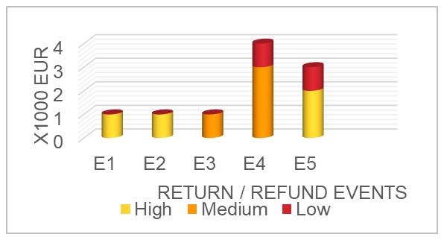

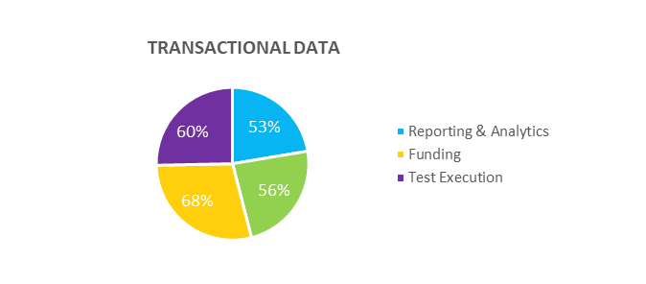
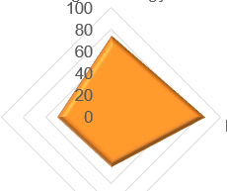
Feasibilities To Solve Problems
Templates of Visual data
ANALYSIS - MONEY ON TABLE
Transaction list (ARN)
Disputes Domain
DEV Portal
APIGEE
Payment Gateway / Data Analytics
Disputes Case list (ARN)

Slide 5
Merchant Business - Value Add
If these views are made as optional Visual Templates through design tools, Our Clients can
Be aware of the Money on the Table left every quarter
Identify Problematic areas
Take decision prime areas to be invested to remediate Business
Monitor improvements after investments were made on relevant areas
Improve on the likelihood of Customers recommending our client Business
Reduce the time spent on preparing such reports, Web / Backend Developments
Improve Cash in hand that will make our client Business strong enough to fight Recessions / Market fluctuations
Help on the view where the client can invest customer

